Slide 1
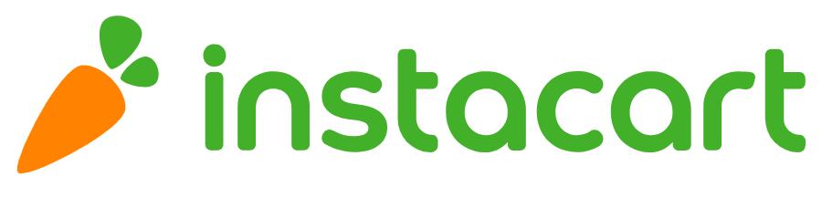
Group P- Anshika Ahuja, Apoorv Mehrotra, Arnav Deshwal, Jake Hill, Vikrant Vaidya

Slide 2
First, let’s look at our data!
Order_Products
Order_id
Product_id
Add_to_cart_order
Reordered
Orders
User_id
Order_id
Order_dow
Order_hour_of_day
Days_since_prior_order
Products
Product_id
Product_name
Aisle_id
Department_id
Aisles
Aisle_id
Aisle_name
Departments
Department_id
Department_name

Slide 3

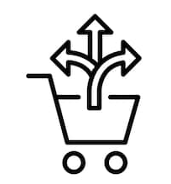
Visitors can either be old or new to the website
Personalised
Generic
Notes:
Site visitors can be of 2 types - old and new. While we know nothing about the new ones, we have a plethora of data about our previous customers which we can use to predict their behaviour and give personalised recommendations which are more likely to provide results vs the generic recommendations we provide to new customers.

Slide 4
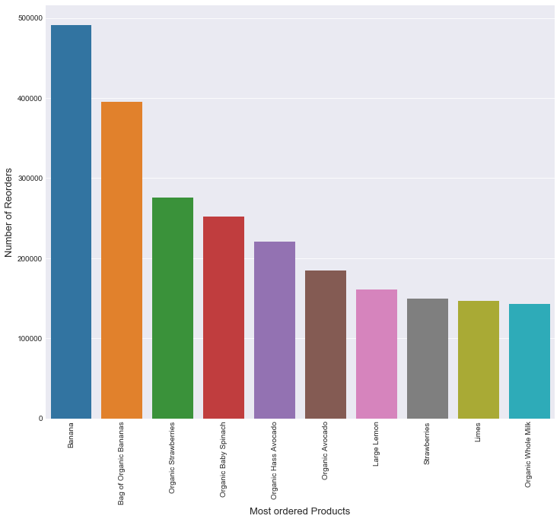
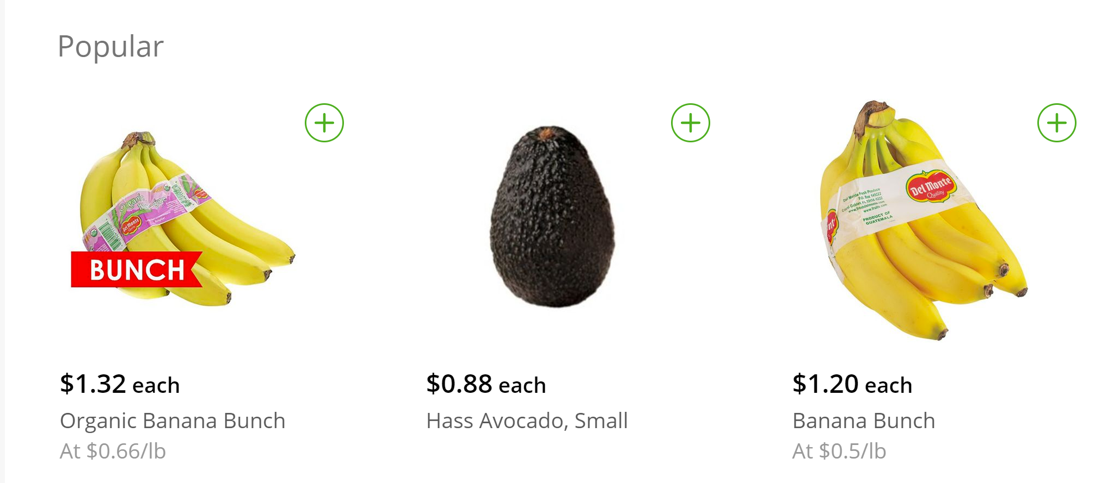
People are going Bananas!
2017
2019
Recommend popular products to new customers
Notes:
Since we have no data on new customers, our best guess is to take the behaviour of the overall population as basis for recommendations to them. Based on that, we recommend most popular items to these customers

Slide 5
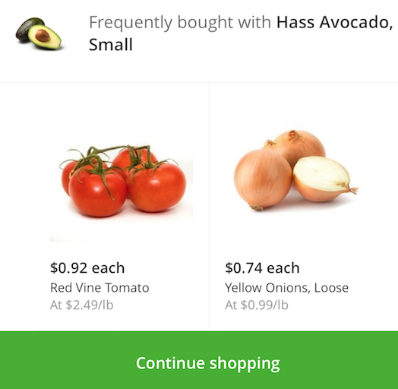
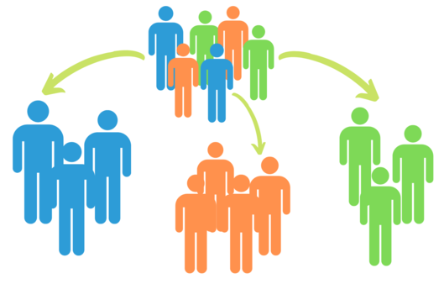
Divide, Conquer and Integrate!
Customer Profiling & Targeting
Recommendation Systems
Notes:
Our approach IS and FOLLOWS the strategy divide (tasks/people), conquer (solve/personalise) and integrate (solution/customers)

Slide 6
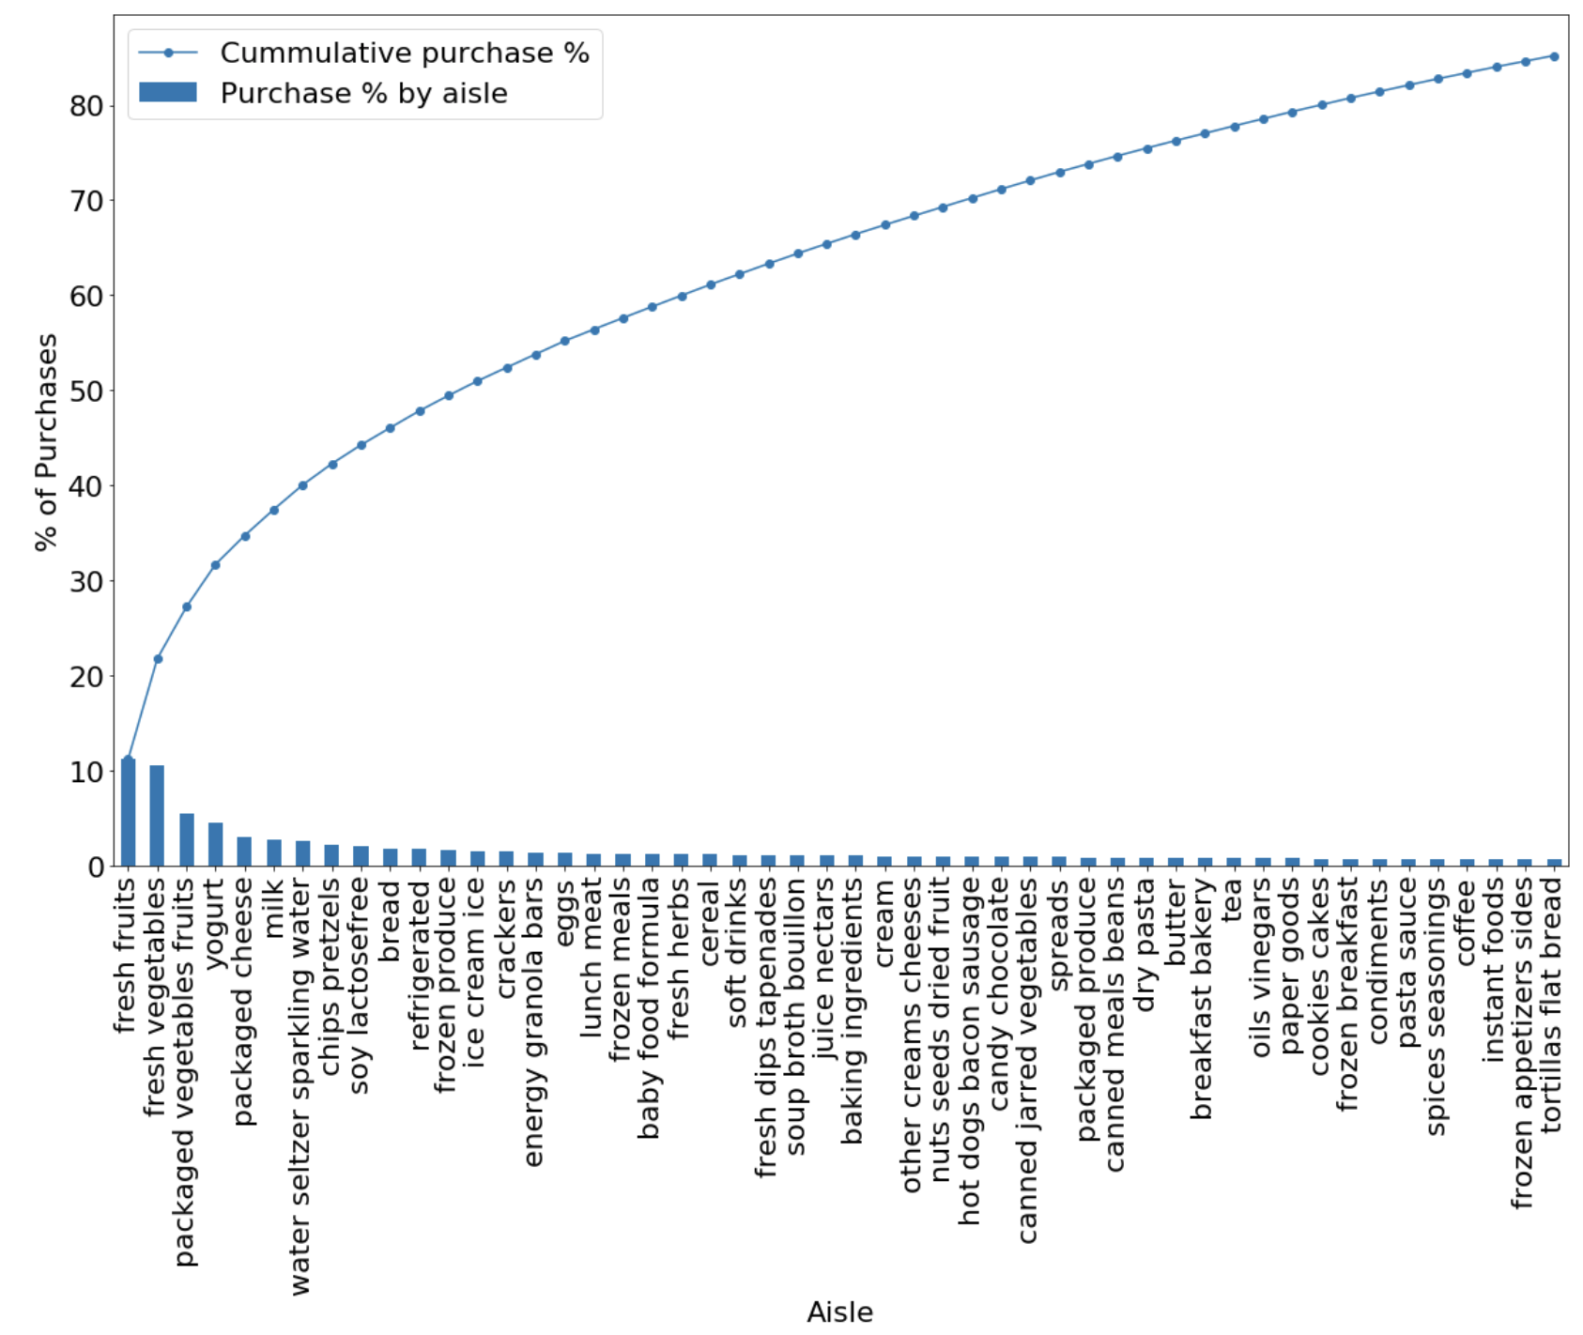
85% of all items purchased come from 35% of the aisles
31% of all products purchased via Instacart are from 4 aisles - fresh fruits, fresh vegetables, packaged vegetables fruits, yogurt
85% of all products purchased via Instacart come from 50 aisles
We will use these top 50 aisles to observe the behavior of our customers in order to segment them
85%
31%
Notes:
Our approach IS and FOLLOWS the strategy divide (tasks/people), conquer (solve/personalise) and integrate (solution/customers)

Slide 7
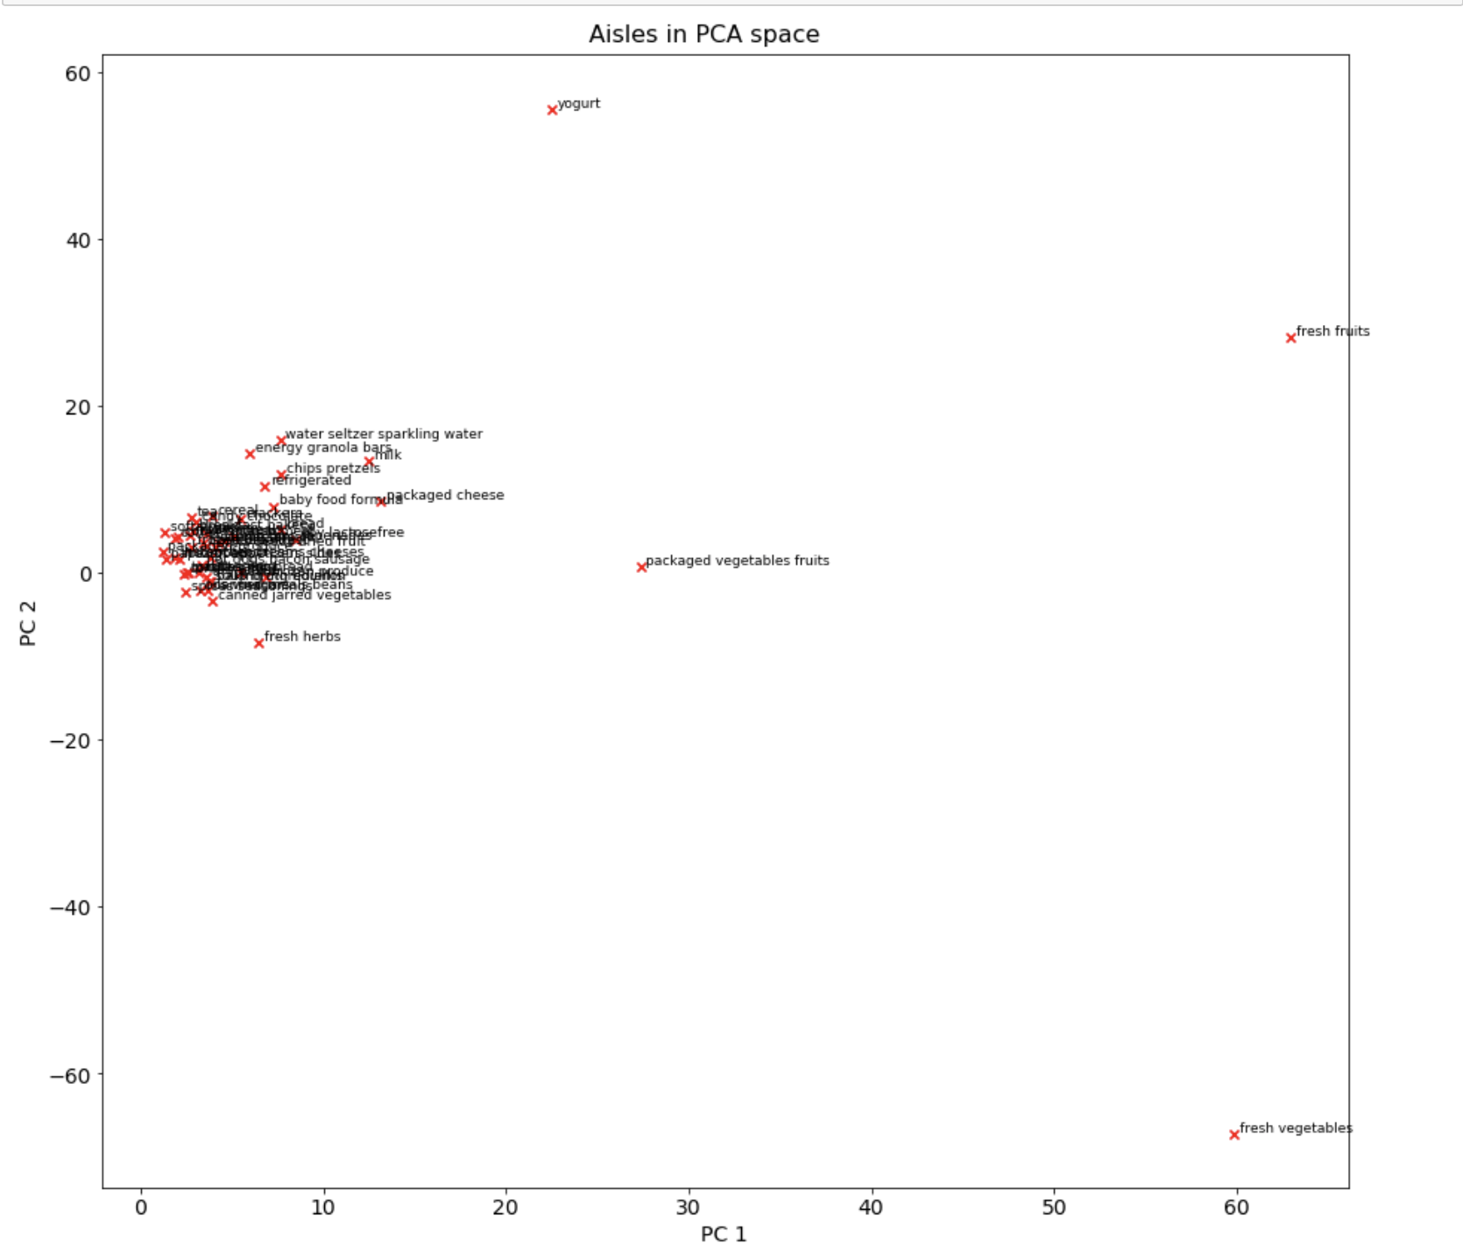
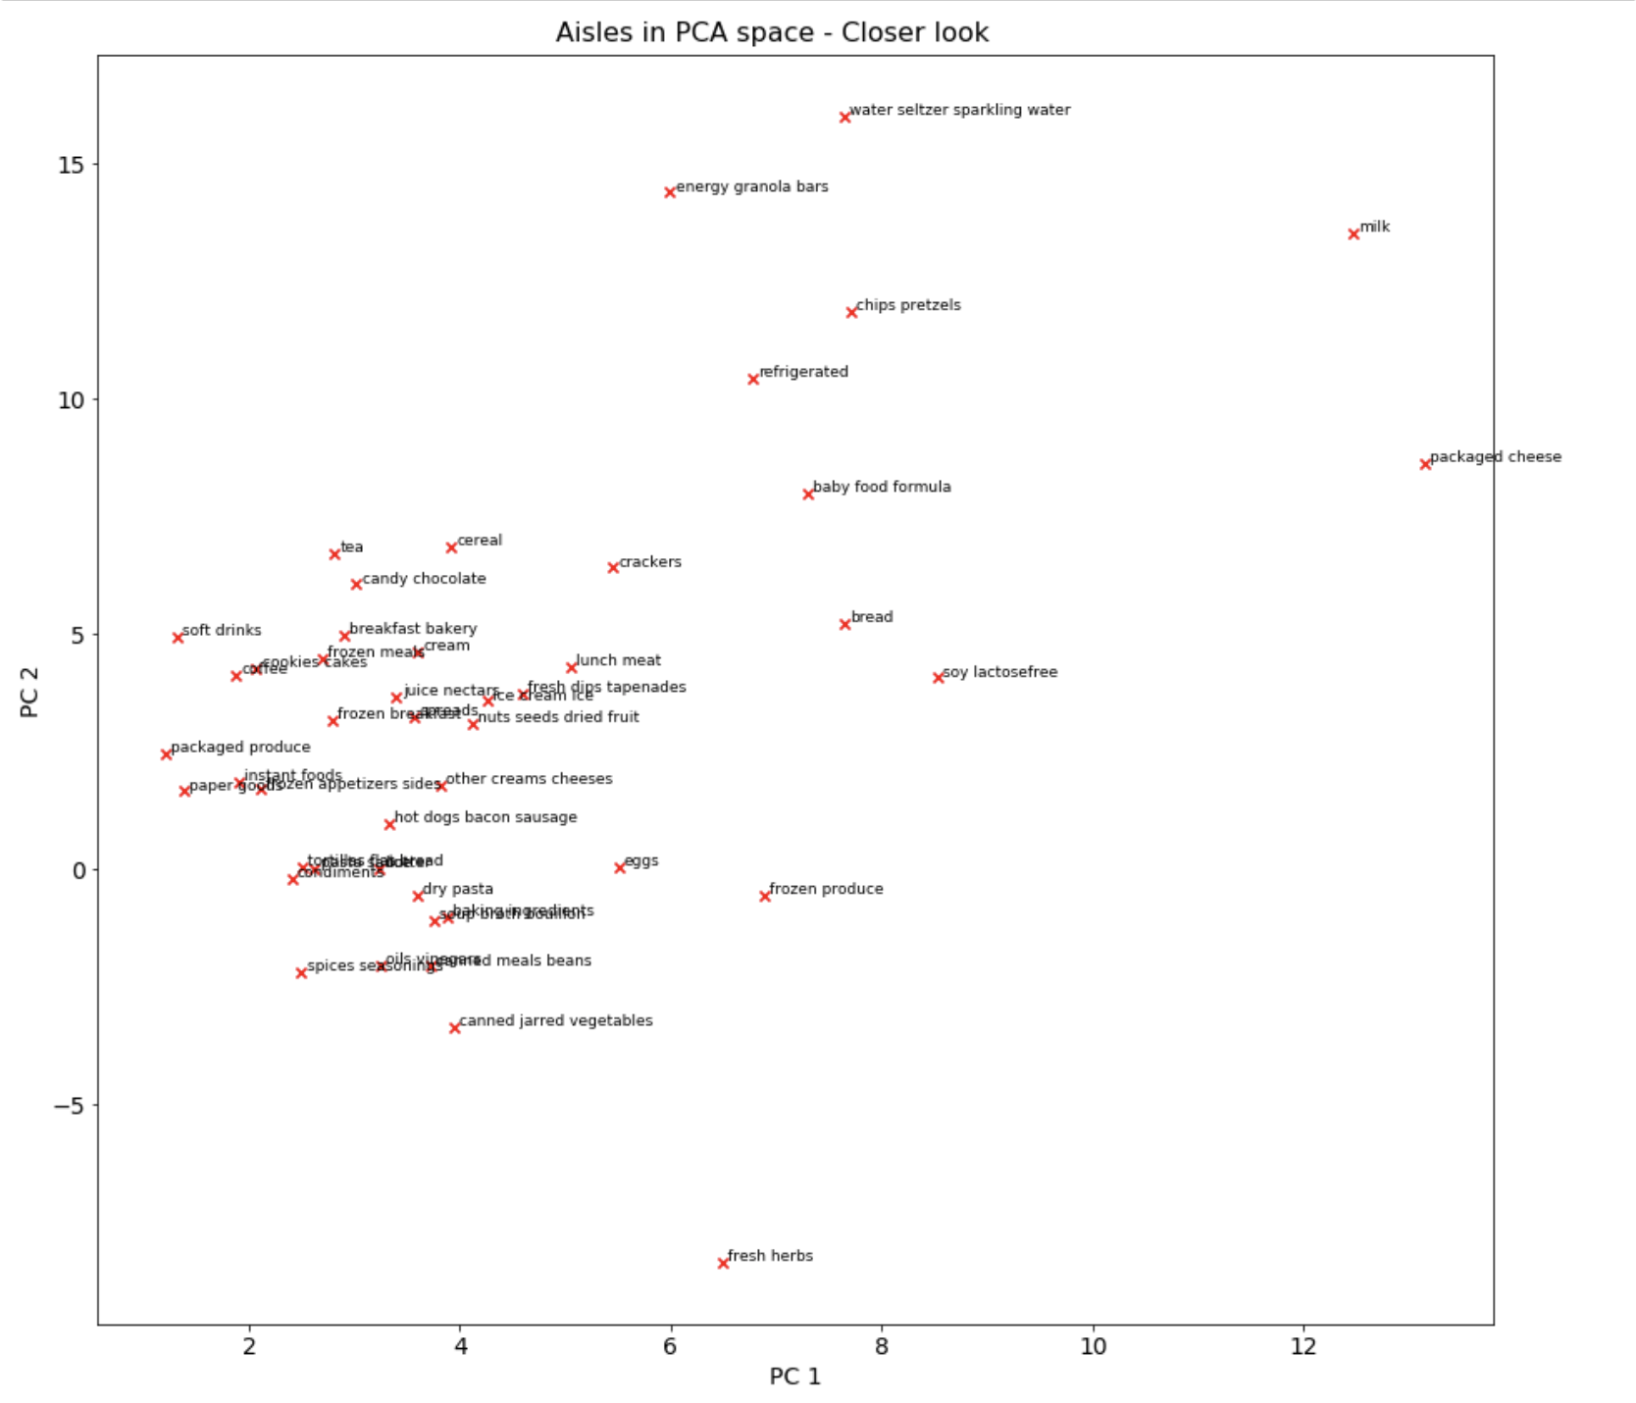
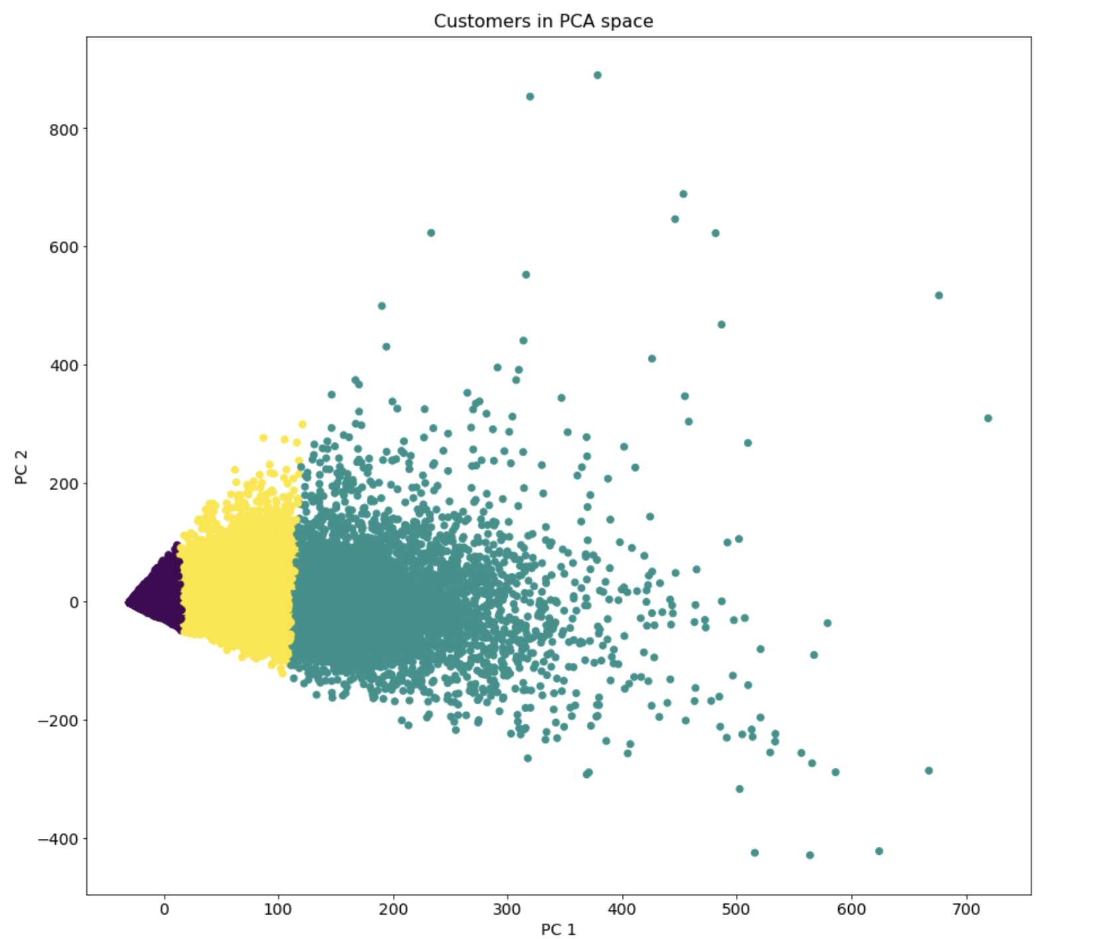
KNN over PCA output provides well separated clusters
We use PCA to reduce the dimensionality from user behavior in 50 aisles down to 2 components that capture ~60% of the variance

Slide 8
Cluster Statistics
Cluster 0
Cluster 1
Cluster 2
% Customers: 81%
%Orders: 54%
% Customers: 4%
%Orders: 13%
% Customers: 15%
%Orders: 33%
Customer Stats
Customer Stats
Customer Stats
Median Orders: 7
Median Order Gap: 16
Median Basket Size (Variety): 6.8
Avg Basket Reorder Share: 50%
Median Orders: 56
Median Order Gap: 6
Median Basket Size (Variety): 13
Avg Basket Reorder Share: 77%
Median Orders: 29
Median Order Gap: 9.5
Median Basket Size (Variety): 11
Avg Basket Reorder Share: 68%
Notes:
% Customers: What % of total customers fall into this cluster
% orders: What % of all orders were placed by customers of this cluster
Median orders: How many orders does the 50th percentile customer place? (How does a typical customer look)
Median order gap: How many orders does the 50th percentile customer place? (How does a typical customer look)
Median Basket Size: How many orders does the 50th percentile customer place? (How does a typical customer look) - since we don’t have quantity of order, the basket size talks about the variety of the basket
Average Basket Reorder Share: On an average, what % of the basket items are reordered ones?

Slide 9




Most of the customers are buying less
Ideal Cluster
Target Cluster
Target Cluster Customers
Buy less times
1
Transaction/Customer
0.1x
Median order gap
Buy less often
1
2.7x
Buy less items
1
Basket Variety
0.5x
1
Basket Reorder Share
Buy less repeated items
0.7x
Notes:
80% of our customers drive 50% of our orders and 43% of all purchases (target cluster)
Basket variety for target cluster is half of frequent purchasers on average
Target cluster customers transact at triple the order gap on an average (vs. the most frequently transacting cluster)
Cross-selling will improve assortment and frequency (more products with replenishment requirement) (recommendation results attached in appendix)

Slide 10
Recommendations are the key!
Buy less times
Buy less often
Buy less repeated items
Buy less items
Recommend items that customers who buy more often, repeat more often
Recommend complementary items

Slide 11
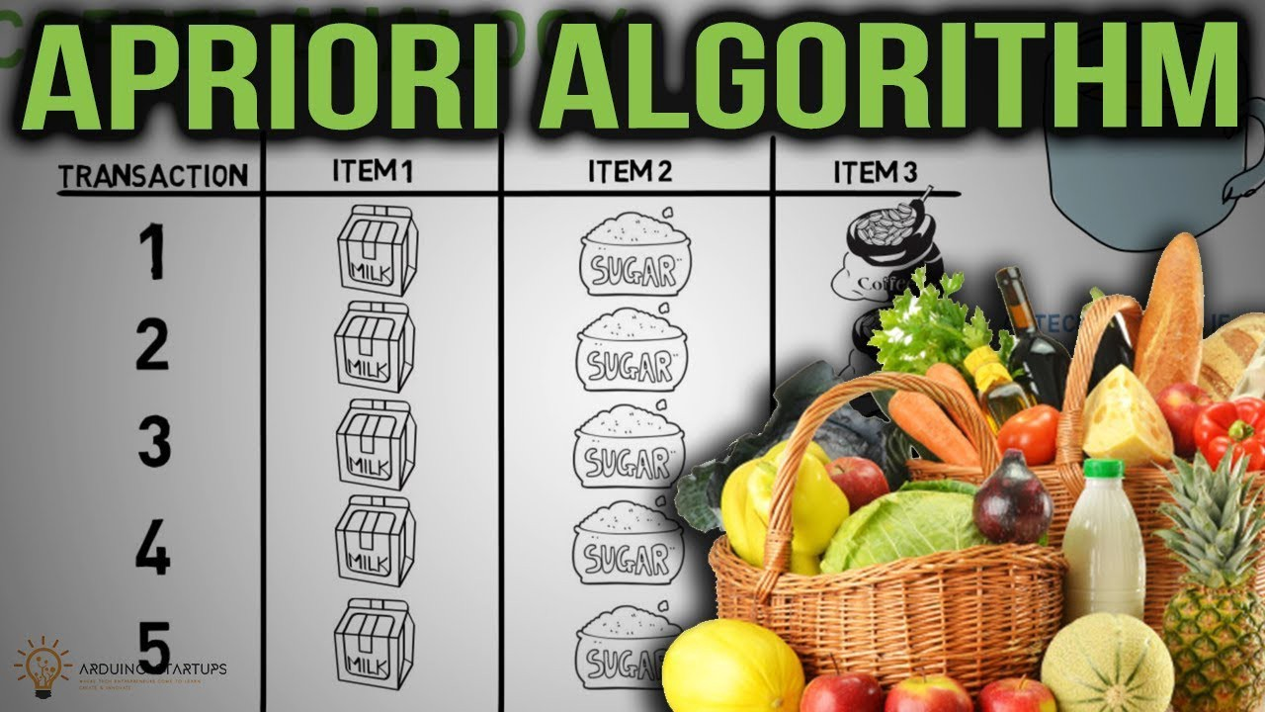
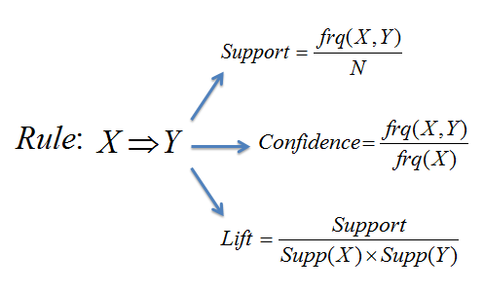
How we built our Recommendation Systems
Association rule based
Repeat based
1.
Identified target and ideal audience
2.
Identified similar items that are reordered more by ideal audience

Slide 12
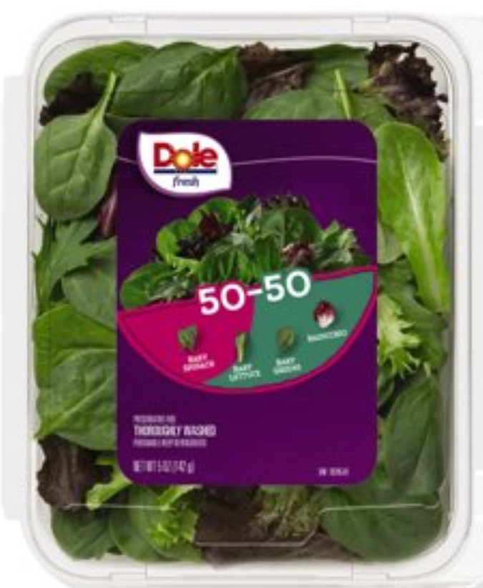
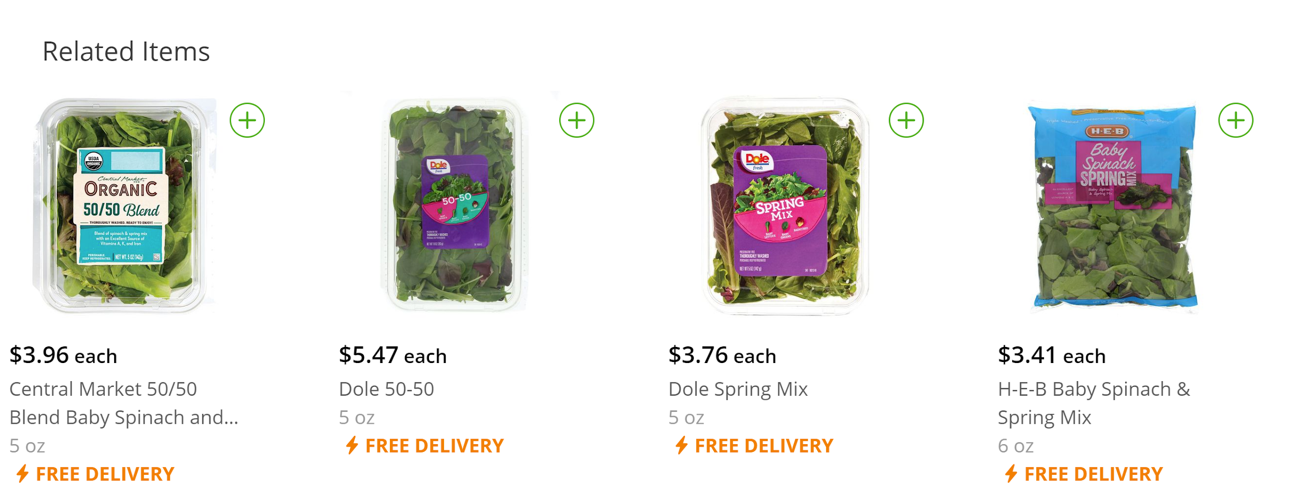
Recommendation system 1: Apriori
Identified cluster 0 customers as target, cluster 1 customers as ideal
Cluster 0 customers have basket variety half of that of cluster 1 customers
Recommend complementary items based on lift scores
Lift score = 5
Limitation: 31% of the transactions were coming from 4 aisles only - most of the products had very low support, and hence most itemsets had low confidence numbers

Slide 13
Recommendation Engine 2: Repeat Based Example
Identified cluster 0 customers as target, cluster 1 customers as ideal
For each cluster, for each item, calculate:
number of orders where a user ordered the product for the first time (order count)
number of orders where a user reordered the product (reorder count)
Heuristic: Reorder score = (reorder count)/(order count)
For target cluster, for each product with low repeat, recommend from ideal cluster:
Products from the same department/aisle that have a higher reorder score than that product and reorder score > 1
Final recommendations: Products from same department/same aisle, which ideal customers tend to repeat more often!

Slide 14
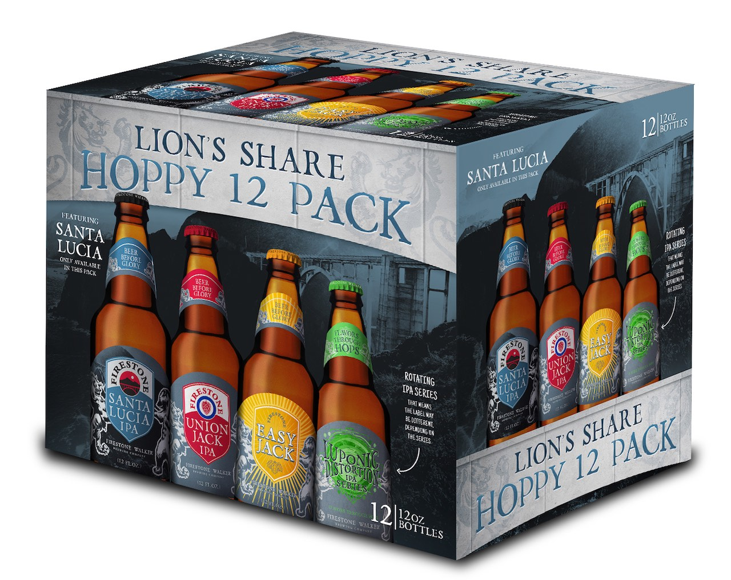
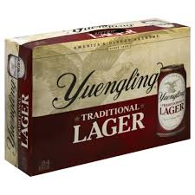
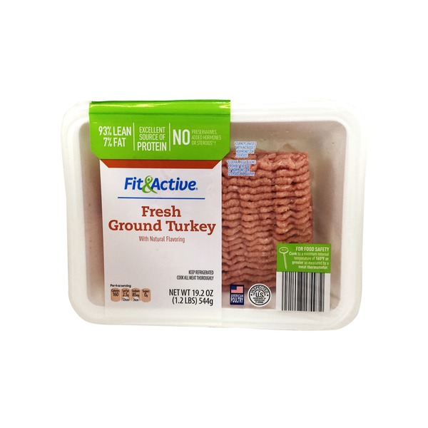
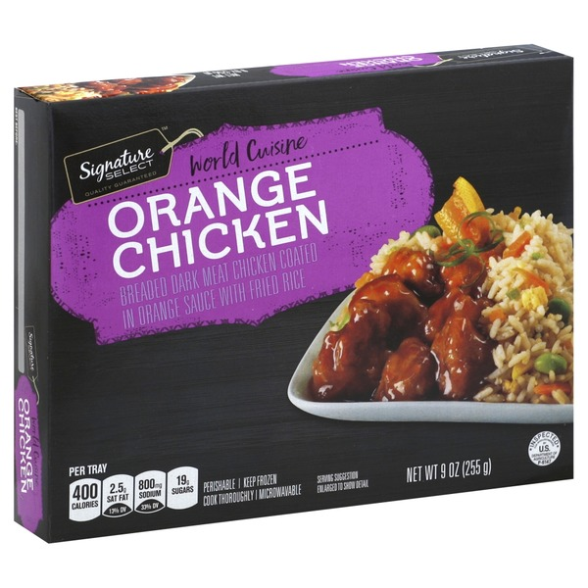
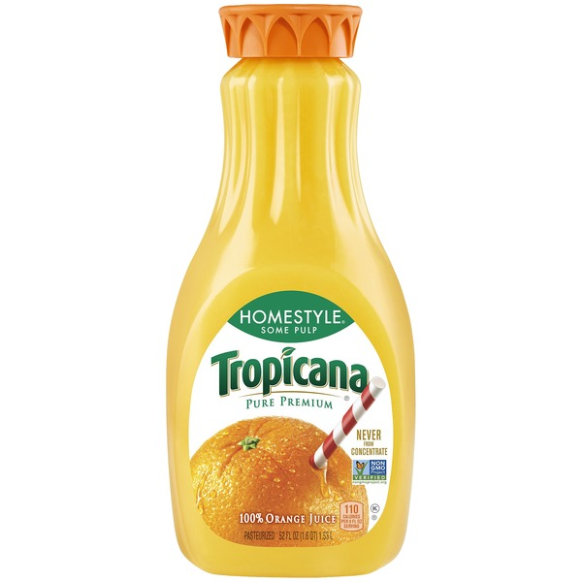
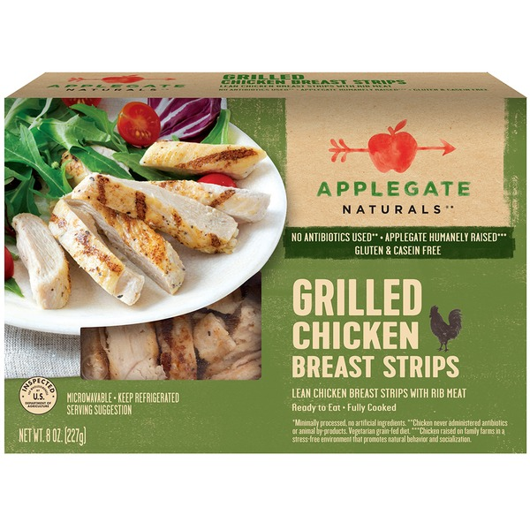
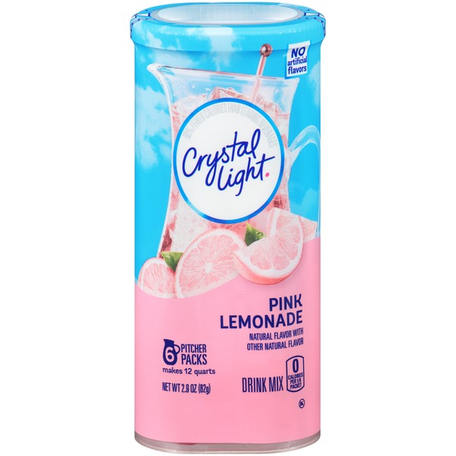
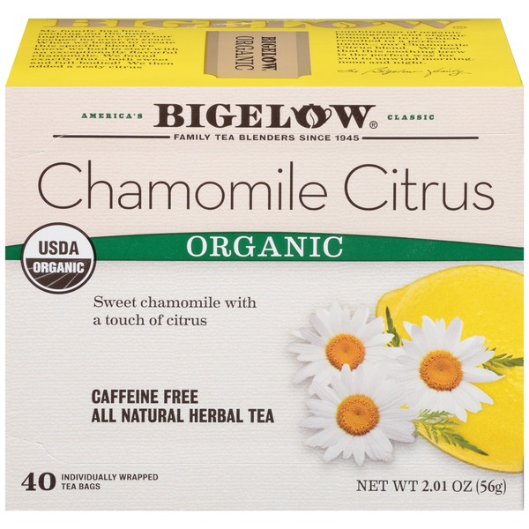
Recommendation Engine 2: Repeat Based
Target cluster Reorder score = 1.325
Ideal cluster Reorder score = 67
Target cluster Reorder score = 0.43
Ideal cluster Reorder score = 4.3
Ideal cluster Reorder score = 47
Ideal cluster Reorder score = 6
Target cluster Reorder score = 0.73
Target cluster Reorder score = 0
Notes:
Products from the same department that are repeated more often by customers who transact more often

Slide 15
Future Scope
Demographic similarity based recommender system:
If demographic data becomes available, find lookalike of each target cluster customer in ideal cluster
Recommend products that most similar users from ideal cluster buy most repeated/most penetrated items (penetration = # orders where products was purchase/# orders for user)
Further segment customers based on demographics, purchase behaviour (with qty and $ data):
A/B test all 3 recommendations for different customers to see what works best for which type of customers
Create logic for composite recommendations based on A/B testing results for different clusters to productionalise

Slide 16
Summary - Recommender comparison
 | Apriori | Reorder | User Based
Goal | Increase basket diversity | Increase highly repeated product purchases | Recommend products that similar people buy the most
Scope | Cross-selling | Alternate products to boost upselling | Cross-Selling
Pros | Improves basket diversity | Increases reorder chances Easy to change level of recommendation (same aisle, same department) | Different way to look at similarity, recommendations based on 1-1 behaviour similarity assumptions
Cons | Scope limited to same aisle and high support products due to computational limits | May provide very different recommendations based on recommendation level department | Needs another model to estimate and verify user similarity accurately before recommendations can be made
Data | Available | Available | Not Available

Slide 17
Questions?

Slide 18
Thank you :)

Slide 19
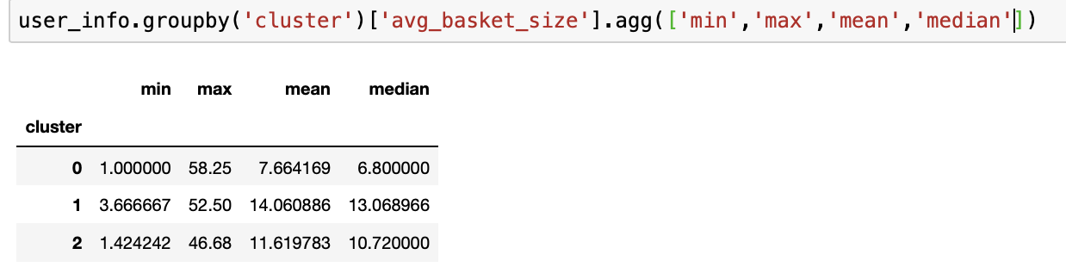
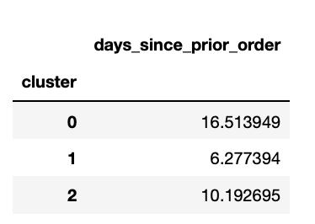
Appendix

Slide 20
Future Scope
Target ideal cluster to identify basket size related metrics and try to increase number of customers who transact like them
See demographics etc. for target cluster to see what works for them
Look at the monetary data for each transaction on user level
Analyze the quantity of each product bought in each order by different users to gain more insights into customer’s buying patterns

Slide 21
FPM Results
https://drive.google.com/file/d/1q1g4Bv1nB25hxCj1efsK_Tv4KT7J00Iw/view?usp=sharing

Slide 22
Overview
Exploratory Data Analysis
Two Types of customers - New and existing
New Customers - Recommend popular products
Existing Customers are the Real Deal!!!
Problem Statement: How to recommend products to the existing customers of Instacart in the most optimum way?
Approach-
How do our customers behave? CUSTOMER SEGMENTATION
Which customers do we target? CUSTOMER TARGETING
What products do we recommend? RECOMMENDATION SYSTEM

Slide 23
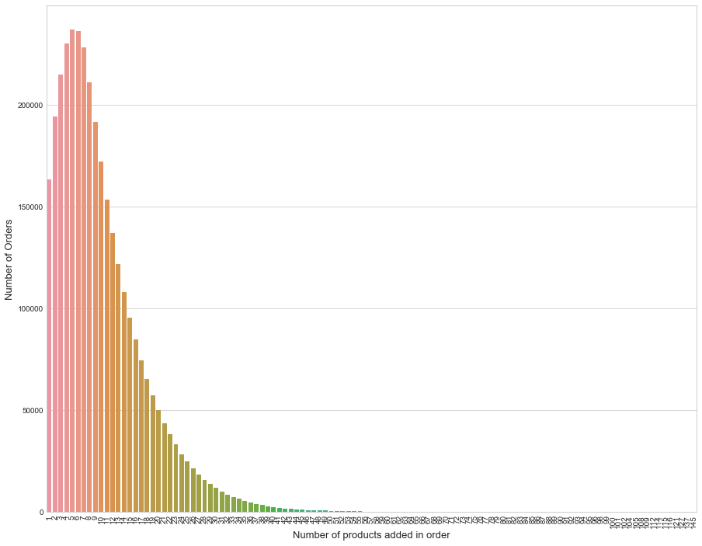
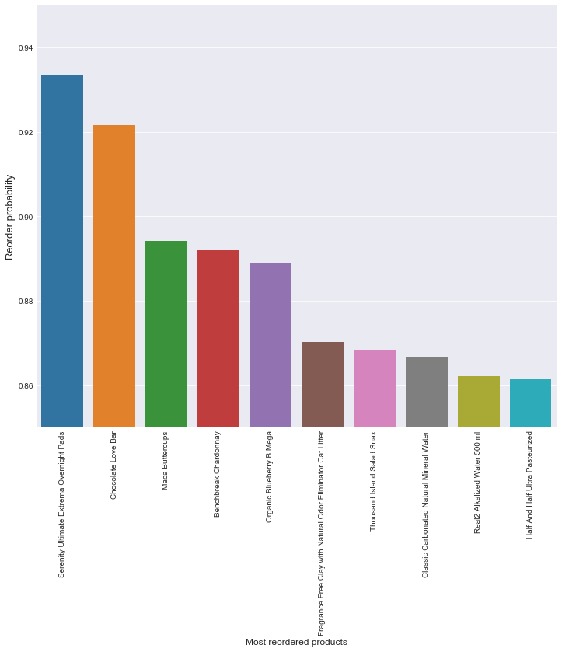
Exploratory Data Analysis
No of orders vs No of products in each order
Top reordered products
Most people order around 5 products

Slide 24
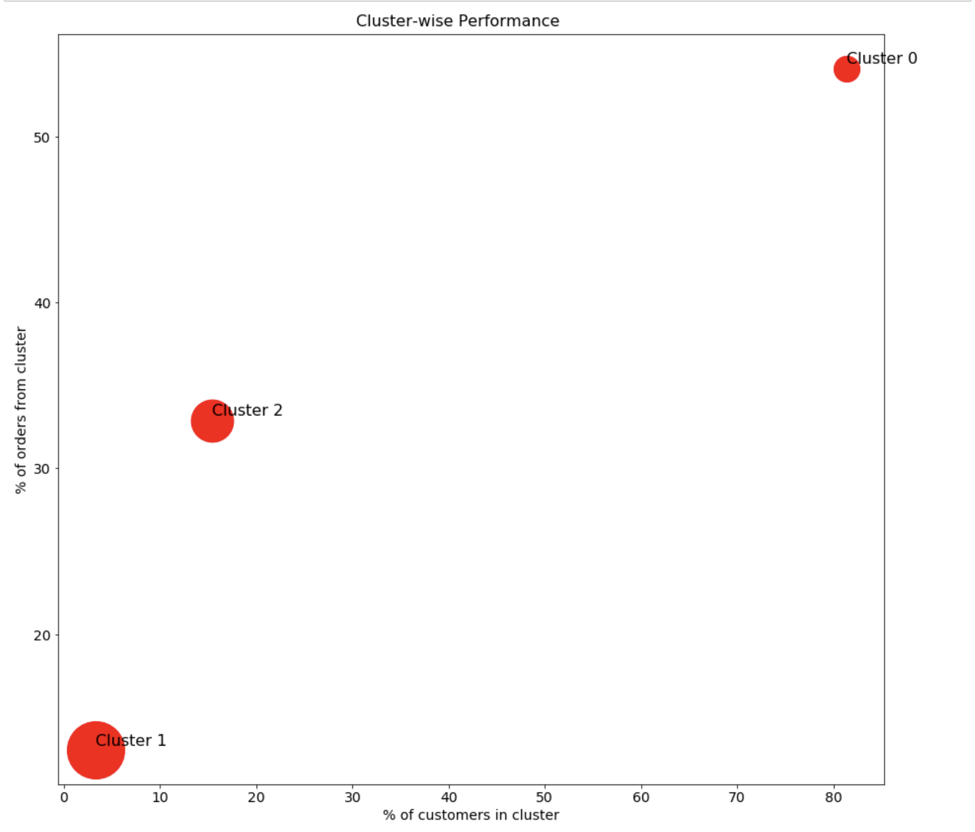
Cluster 0 is a gold-mine for cross-selling
80% of our customers and 54% of our orders come from cluster 0, which has the lowest basket size among all 3. Since we do not have data for quantity, we conclude that Cluster 0 has the least diverse baskets among all 3 clusters.
Dot size ∝ avg basket size (unique)
Cluster 0 becomes the ideal population for cross-selling focus

Slide 25

How we built our Recommendation System
Identified target audience

Slide 26
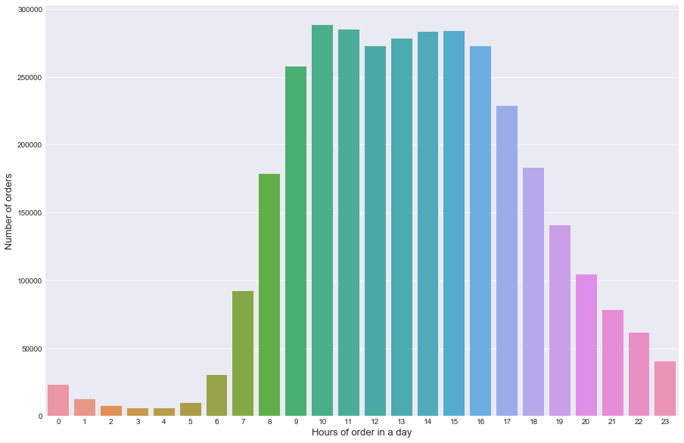
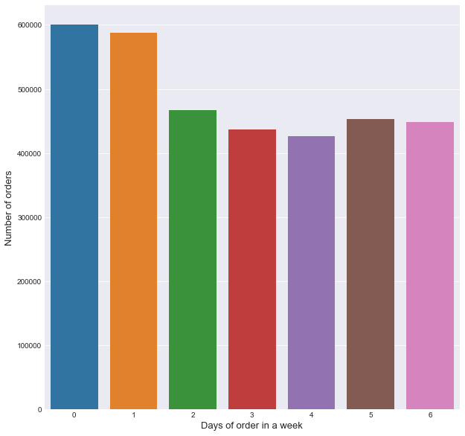
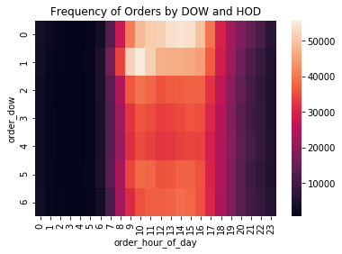
Exploratory Data Analysis
No of orders vs
hours of the day
No of orders vs
day of the week
No of orders vs
day of the week & hour of the day

Slide 27
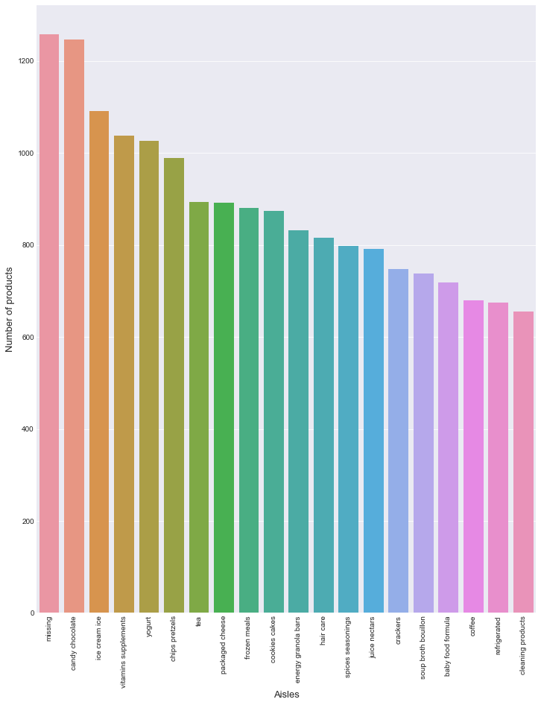
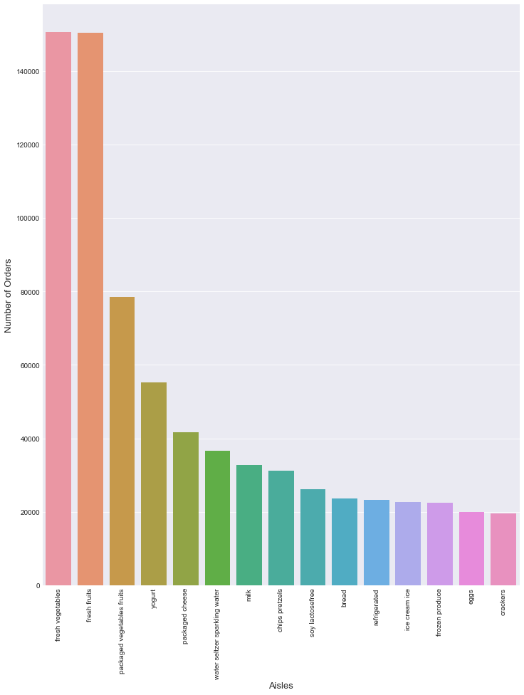
Exploratory Data Analysis
Top aisles by the no of products
Top aisles by the no of orders

Slide 28
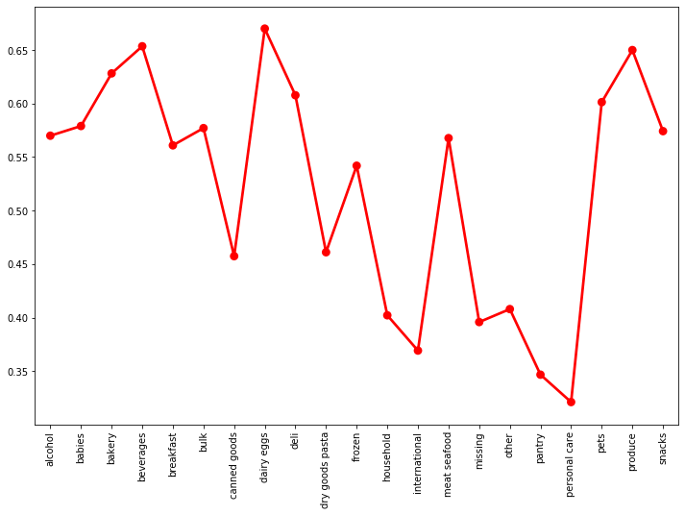
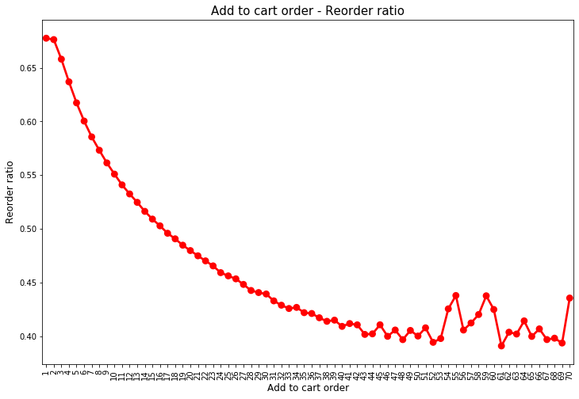
Exploratory Data Analysis
Reorder Ratio vs Department
Add to cart Order vs the Reorder Ratio

Slide 29
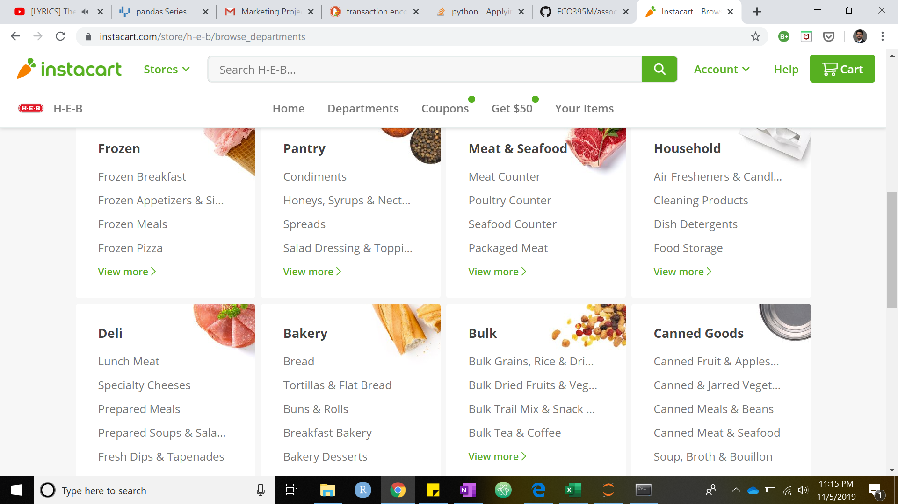
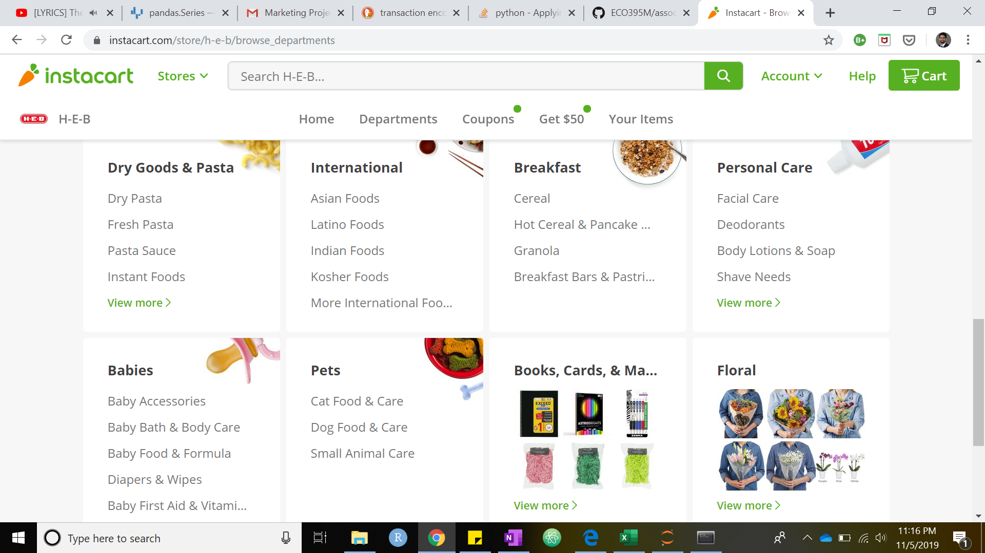
Digital real estate opens the door to “personalised aisles”
Instacart does a good job at utilising their real-estate by creating “aisles” of similar products.
For existing customers, we aim to optimise aisle positioning that is designed to promote cross-selling and up-selling by placing aisles and products with high lifts near each other.
Notes:
We look at the possibility to give recommendations that go beyond the obvious and look at frequent patterns from aisles apart from these top-few obvious items

